Slide 1
Tableau Capstone Project
March 2022

Slide 2
World Population Dataset 2021
Context
Asia has 30% of the world land area, on the land is 61 % of the worlds population lives. Its means every 6 out of 10 people lives in Asia.
As of December 2021, total population worldwide was 7.8 billion.
Total births per sec: 4.2 & deaths per sec: 1.8 .
Content
This dataset associated with population statistics of the world and how population is dispersed throughout this world.
Source of Data: https://www.unfpa.org/data/world-population-dashboard

Slide 3
Problem Statements
Worldwide Total population – 2021.
Total Population by age group – Child & Senior citizen.
Region wise : average women fertility rate.
Top 10 most populated countries information.
Total male & female population continent wise.

Slide 4
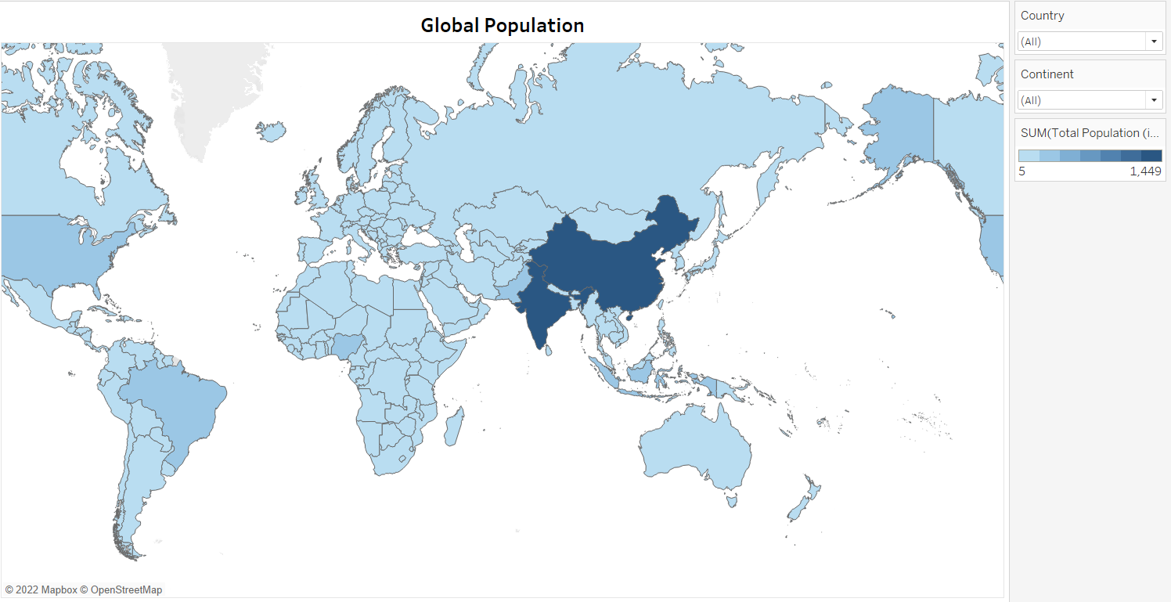
Global Population World map

Slide 5
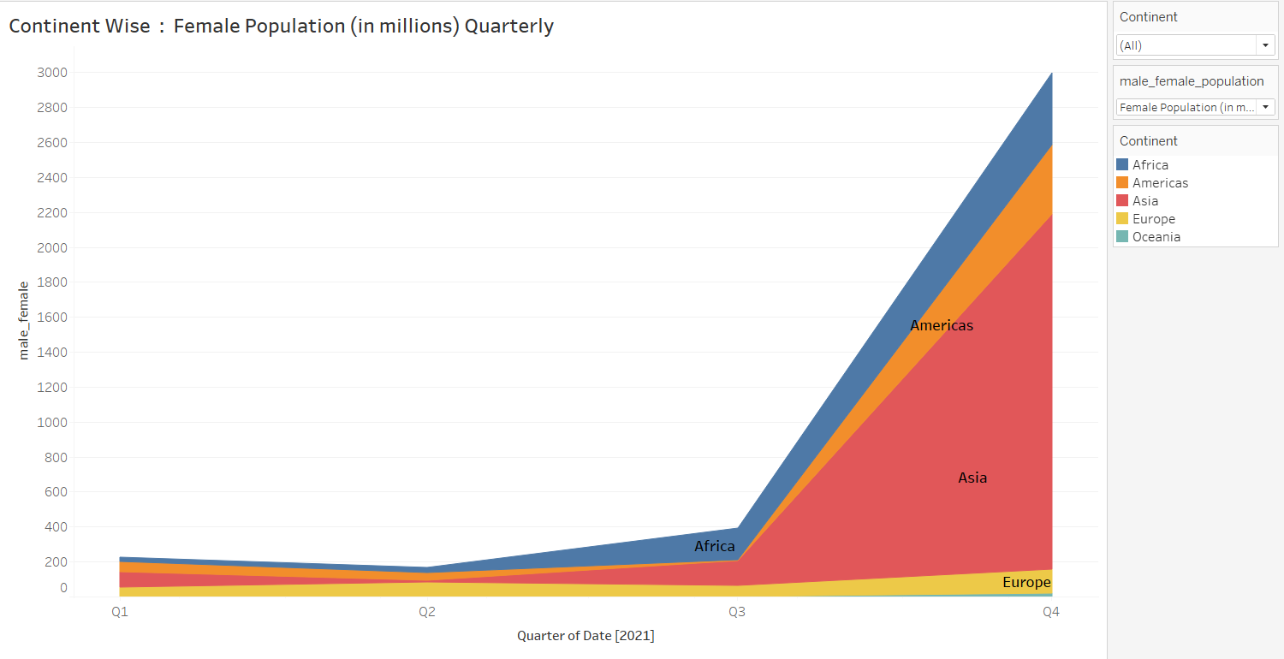
Male-Female population per continent : area chart

Slide 6
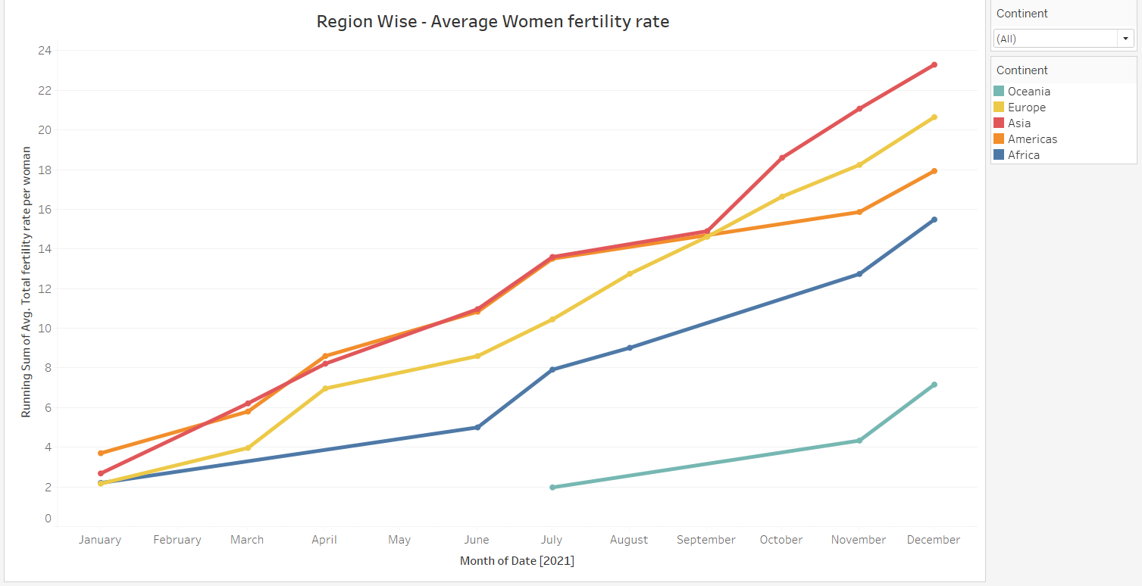
Women fertility rate: line chart

Slide 7
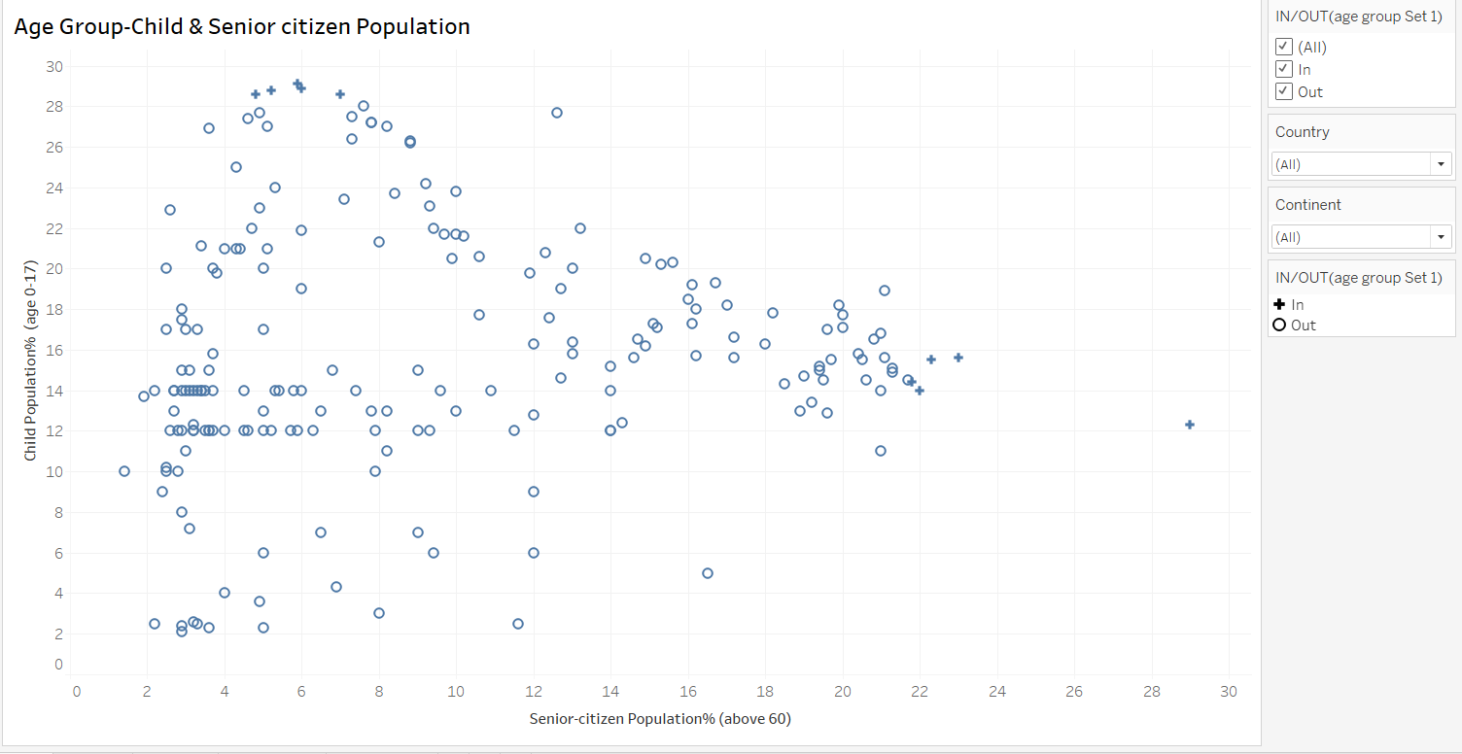
Age group: child – senior citizen population

Slide 8
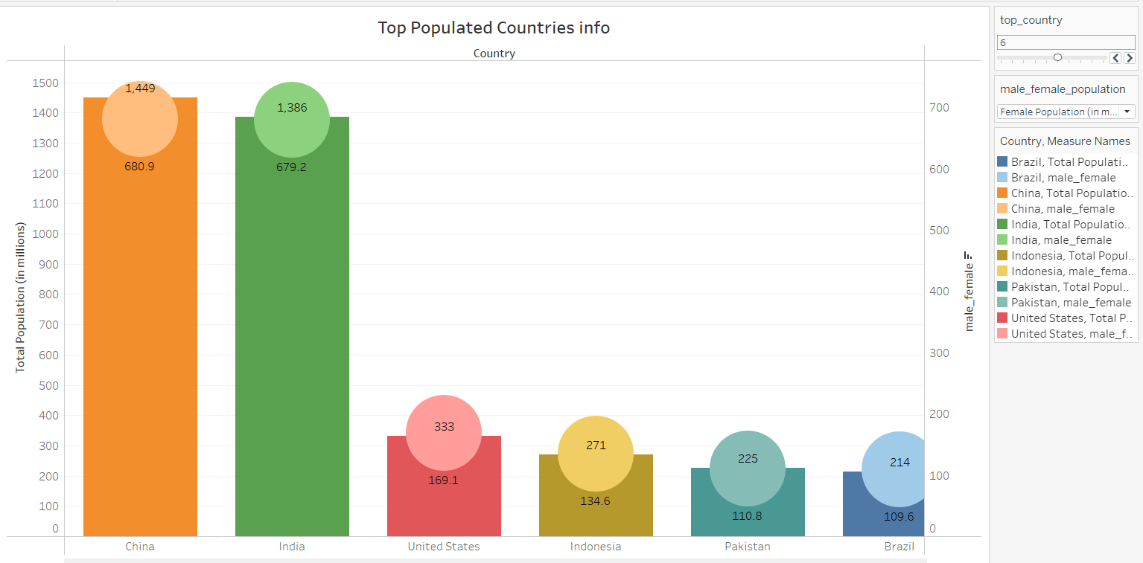
Top most populated countries information

Slide 9
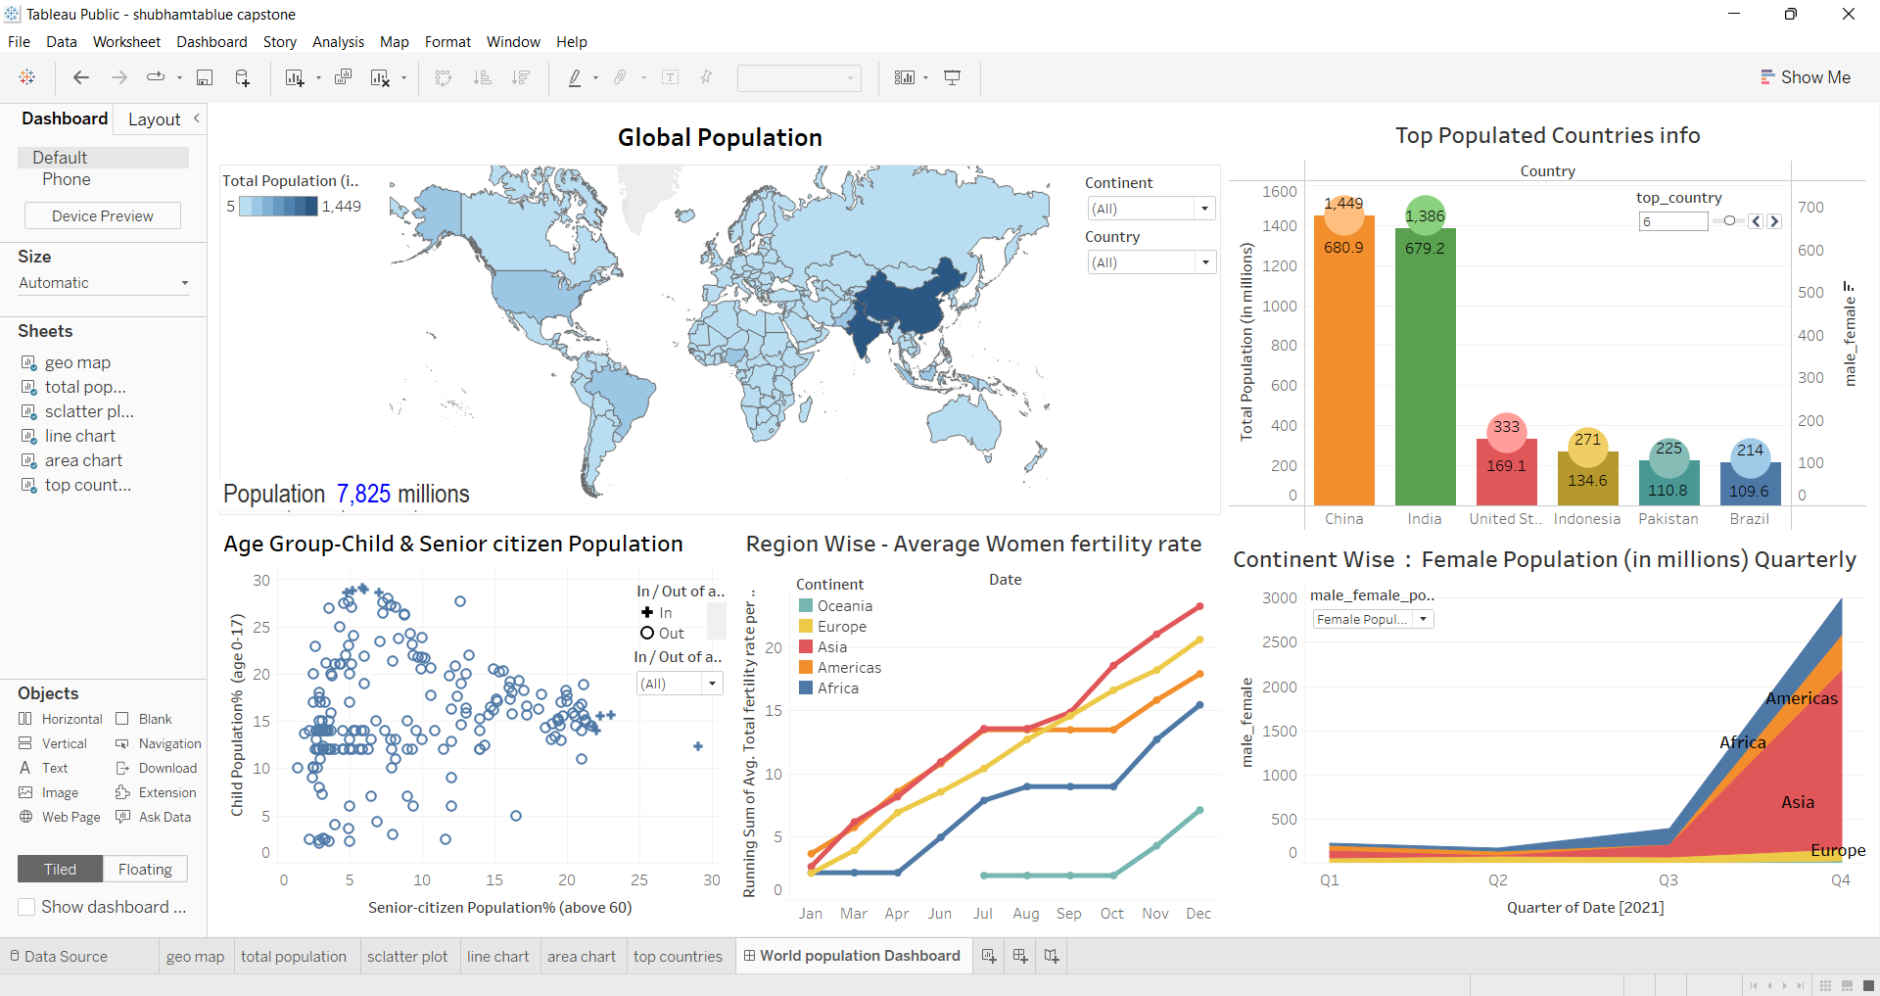
World Population 2021 Dashboard

Slide 10
Summary of the project
As per dataset total population recorded is 7.8 billion whereas Asia continent having highest population, women fertility rate & population growth too.
Top 3 countries- China having 1449 millions(17.80%), India having 1386 million(17.50%) & USA (4.2%) of total world population.
Nepal having highest female population 54.4% & in terms of highest youth population – India is on 1st (464 million).
Japan has became highest senior citizen population 29% because of good healthy lifestyle & also with a highest life expectancy year for both male & female.
Oceania continent & country Vatican city has lowest population in world.
Africa remains the region with highest fertility at 4.7 children per women. Europe has the lowest fertility of 1.6 per women. Both Asia, America & Caribbean have total fertility of 2.2 per woman, closely followed by Oceania with 2.4 per women.
Most of the growth have recorded in 4th quarter 2021.

Slide 11
Conclusion.
With the help of this dashboard, it become very easy to know the data of world population growth in particular country and continent. Analyzing the data is very easy. Multiple charts are joined to the main dashboard in graphical representation.
The outcome helps us to know the total population in different prospective with respect to per quarter, age group, gender, countries, continents etc.
We can classify this data from dashboard.
Please watch this presentation video here- https://youtu.be/EOD91tlmAw8

Slide 12
Thank you

